Slide 1
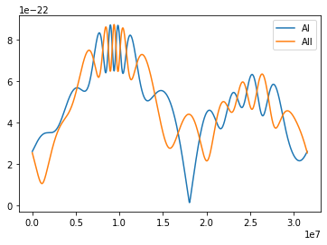
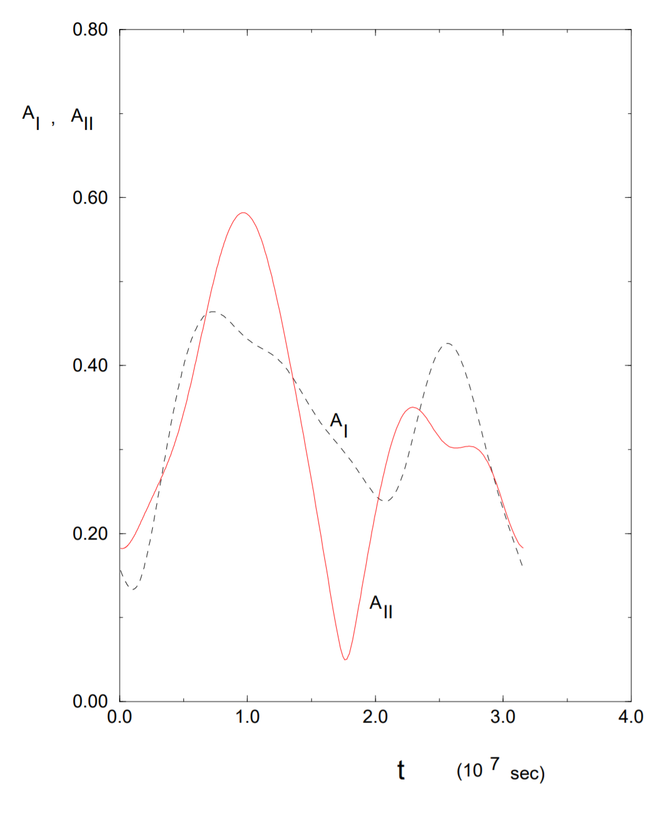
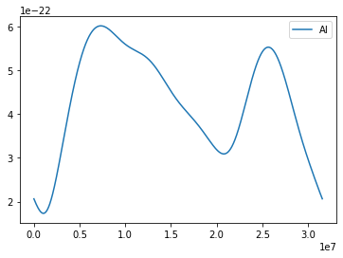
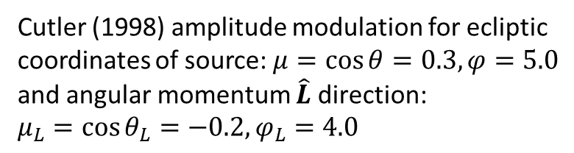
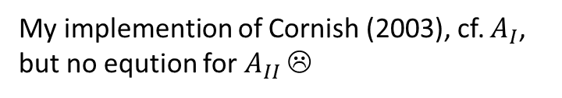
My implementation
My implemention of Cutler (1998) for those same inital conditions ☹
Cutler (1998) amplitude modulation for ecliptic coordinates of source: $μ=\cos{θ}=0.3, φ=5.0$ and angular momentum $\hat{L}$ direction:
$μ_{L}=\cos{θ_{L}}=−0.2, φ_{L}=4.0$
My implemention of Cornish (2003), cf. $A_{I}$, but no eqution for $A_{II}$ ☹

